Slide 1

Analysis of Local and State Tax Collection
Vidya Modugu
University of Dallas
Business Analytics
Data Mining and Visualization – BANA-7320 –2QA
Date: 26th March 2018
Reference Tableau Link : https://public.tableau.com/views/StateTaxAnalysis/Sheet19?:embed=y&:display_count=yes&publish=yes
Stakeholders:
Primary – Tax Payers-Individuals’/Companies etc.,
Secondary- State and Local Governments.

Slide 2
Topic: Analysis of Local and State Tax Collection systems
Driving Question: Are the State and Local Tax Collection systems balanced?
Why this matters:
Unbalanced State Tax collection systems lead to financial discrepancies' and budget deficiencies.
Unbalanced State Tax collection deprive states from state reserves, making it hard for states to defend the states from recessions.

Slide 3
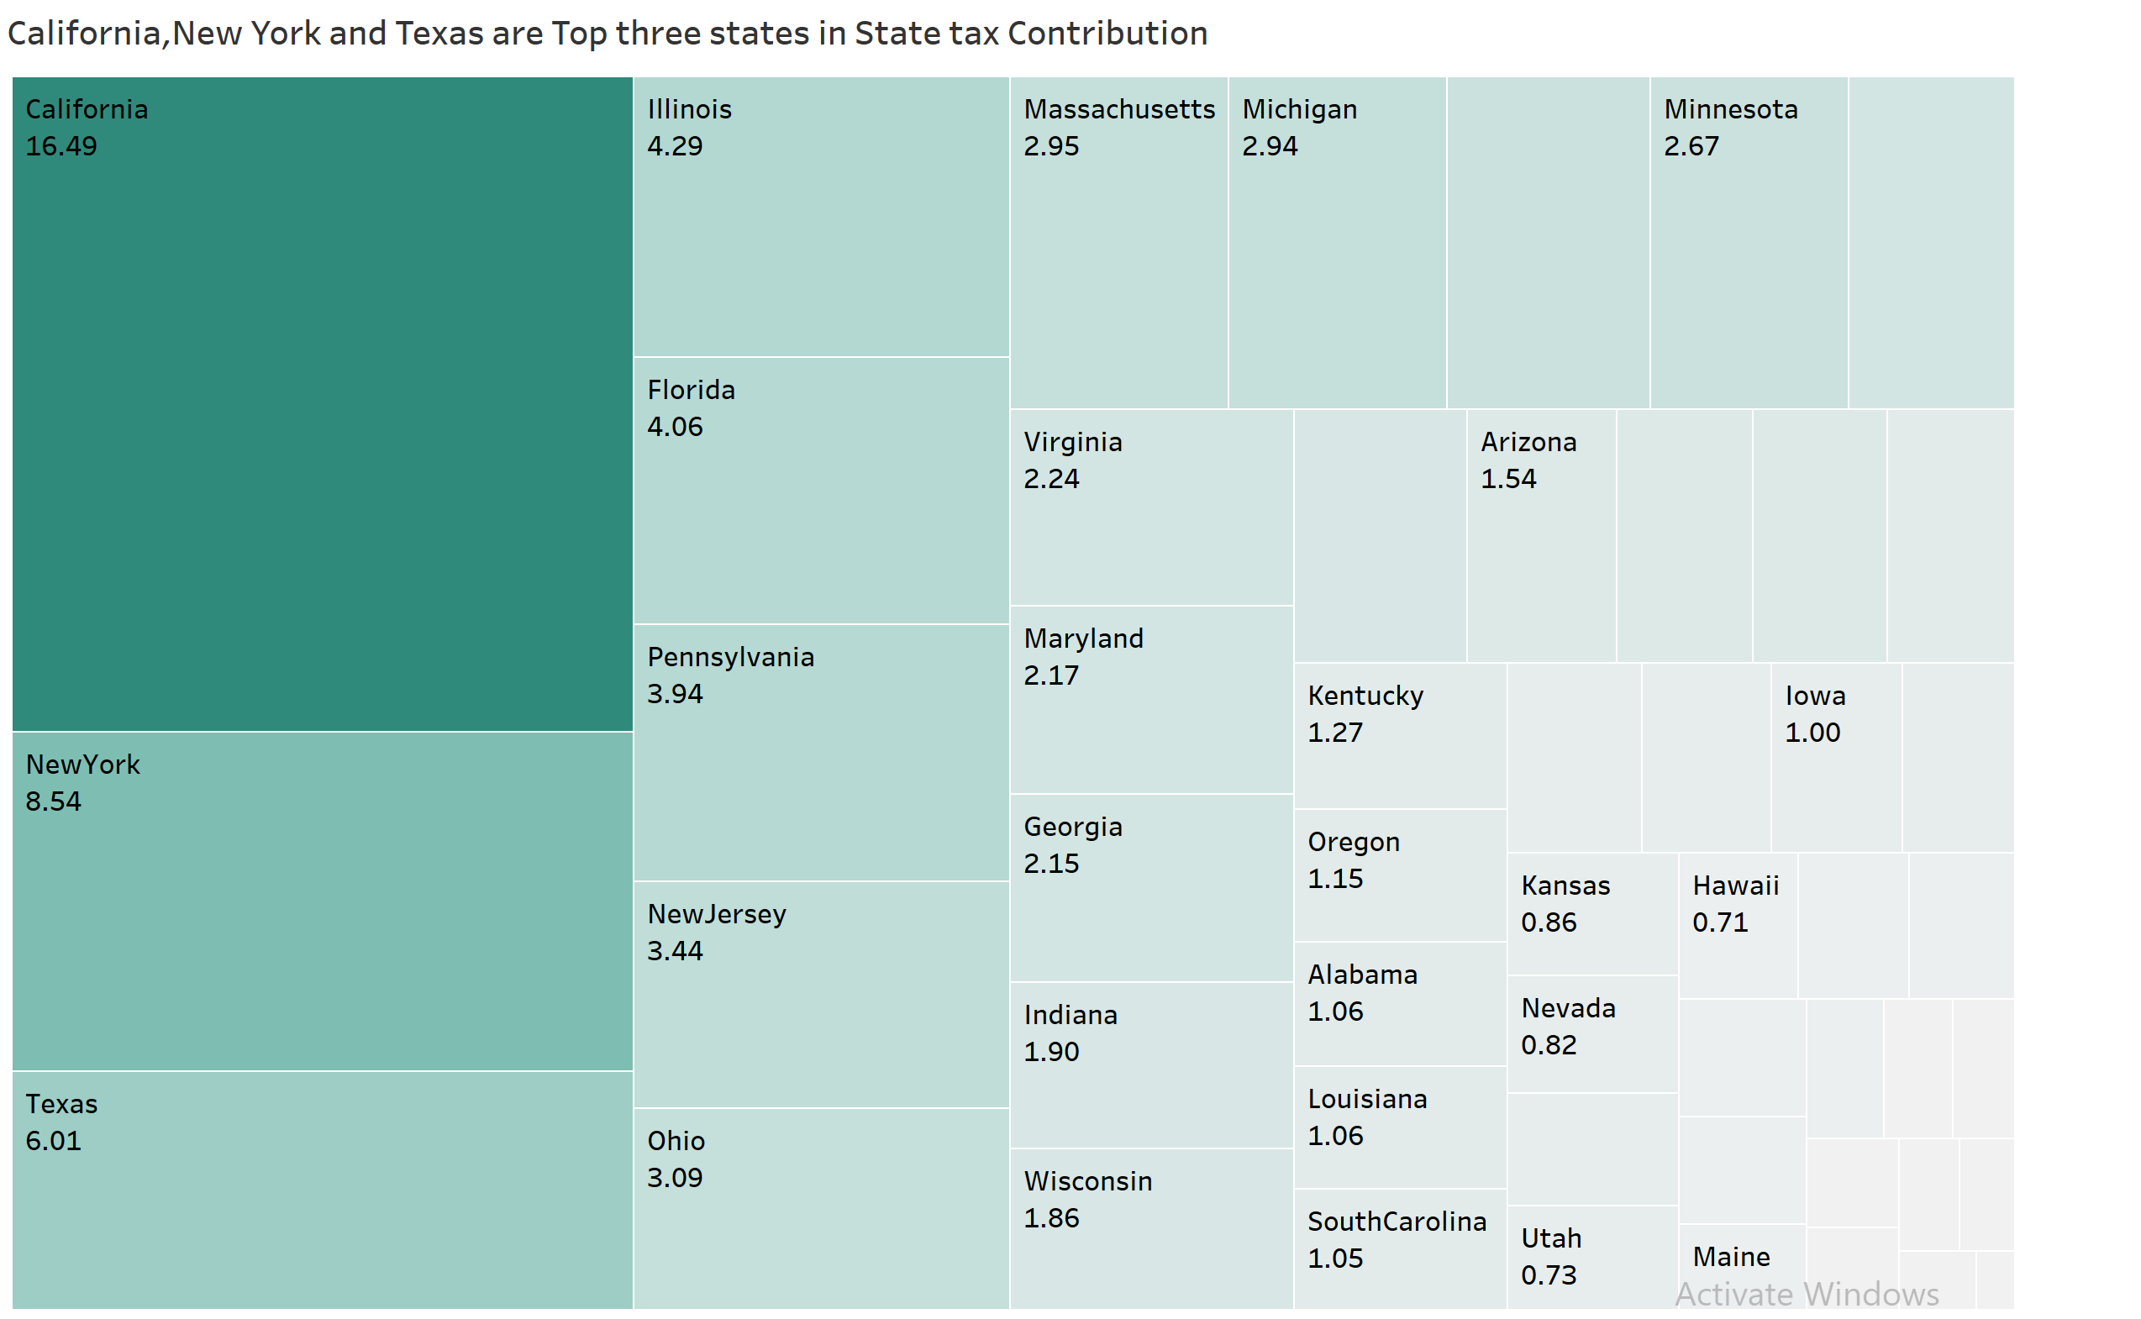
Percentage of Contribution by each state to the total revenues.

Slide 4
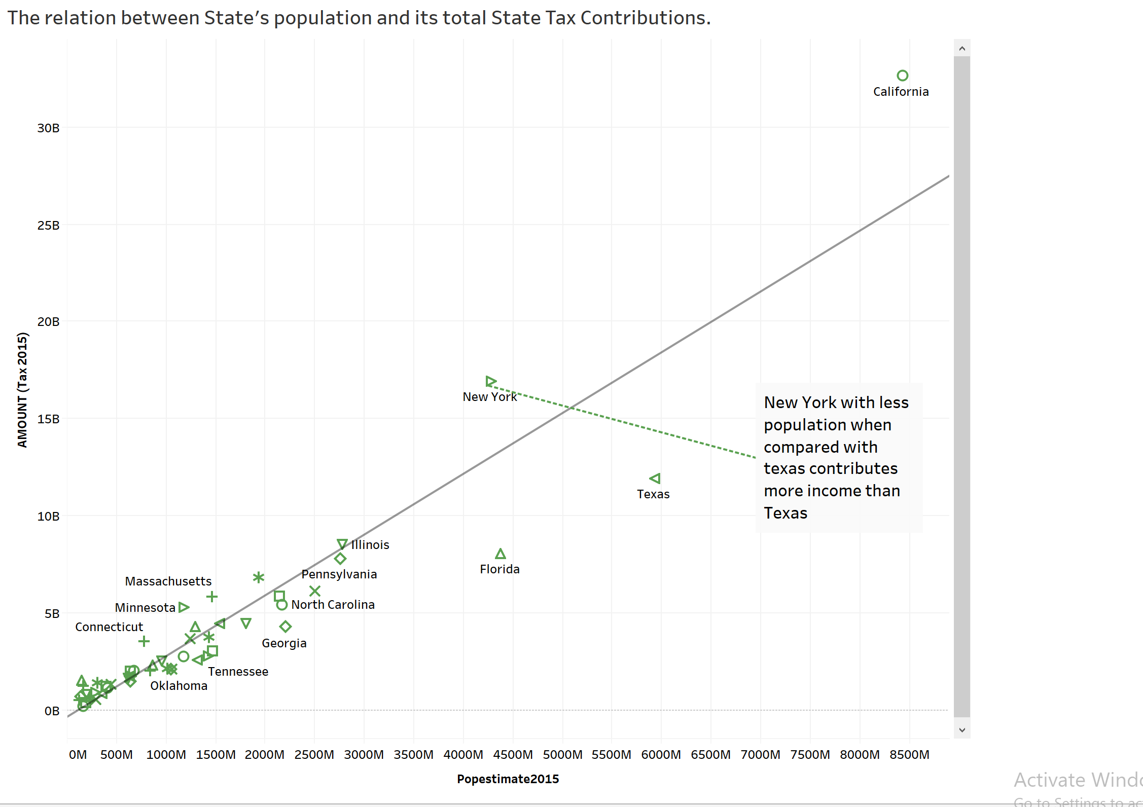
Graph shows some exceptions to the direct relationship of States population and State tax Contribution.

Slide 5
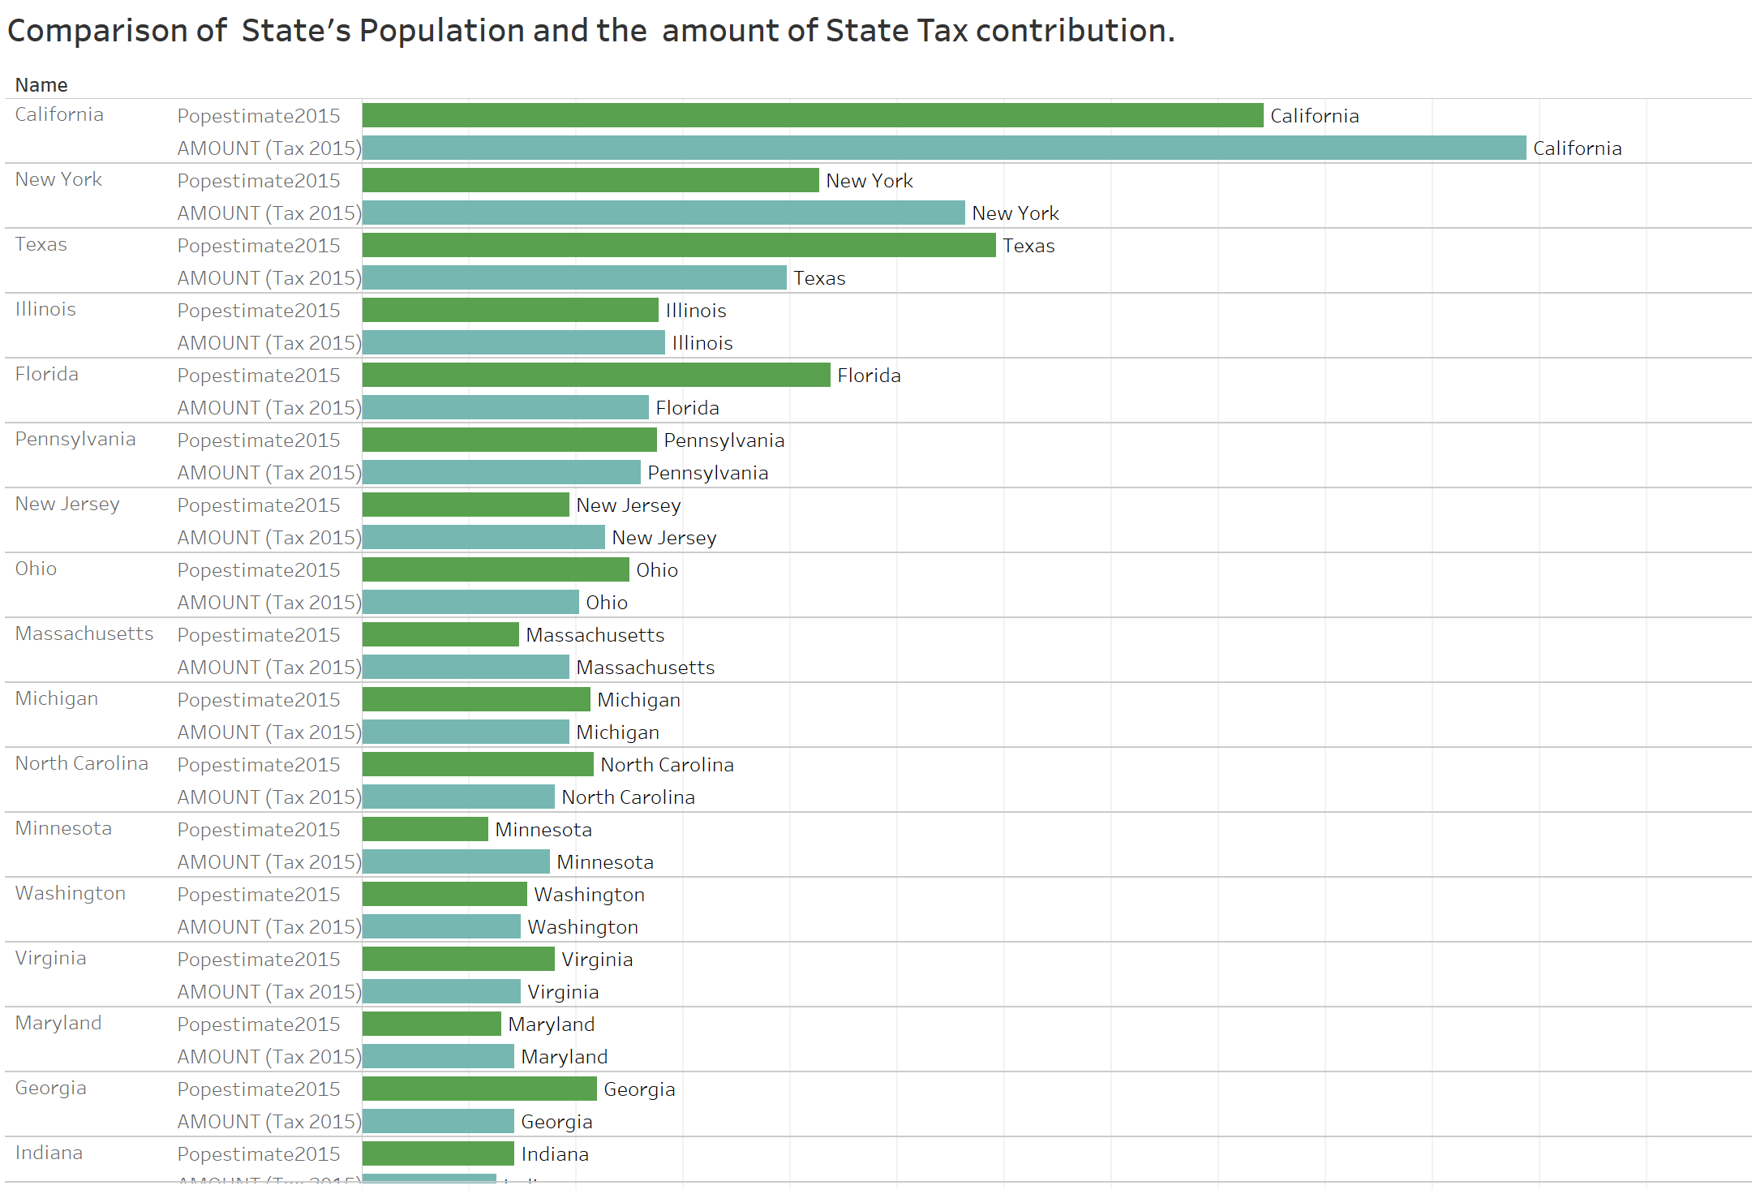

States with equal populations estimates like Illinois, Florida have different Tax Contributions.

Slide 6
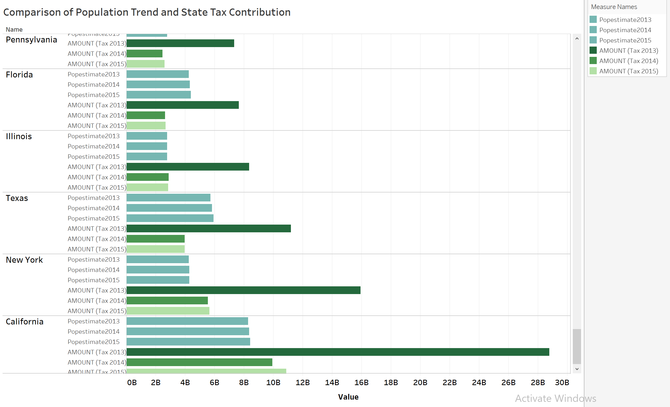
States population estimates show no trend from 2013 –2015, whereas state's Tax contribution shows decreasing trend from 2013-2015

Slide 7
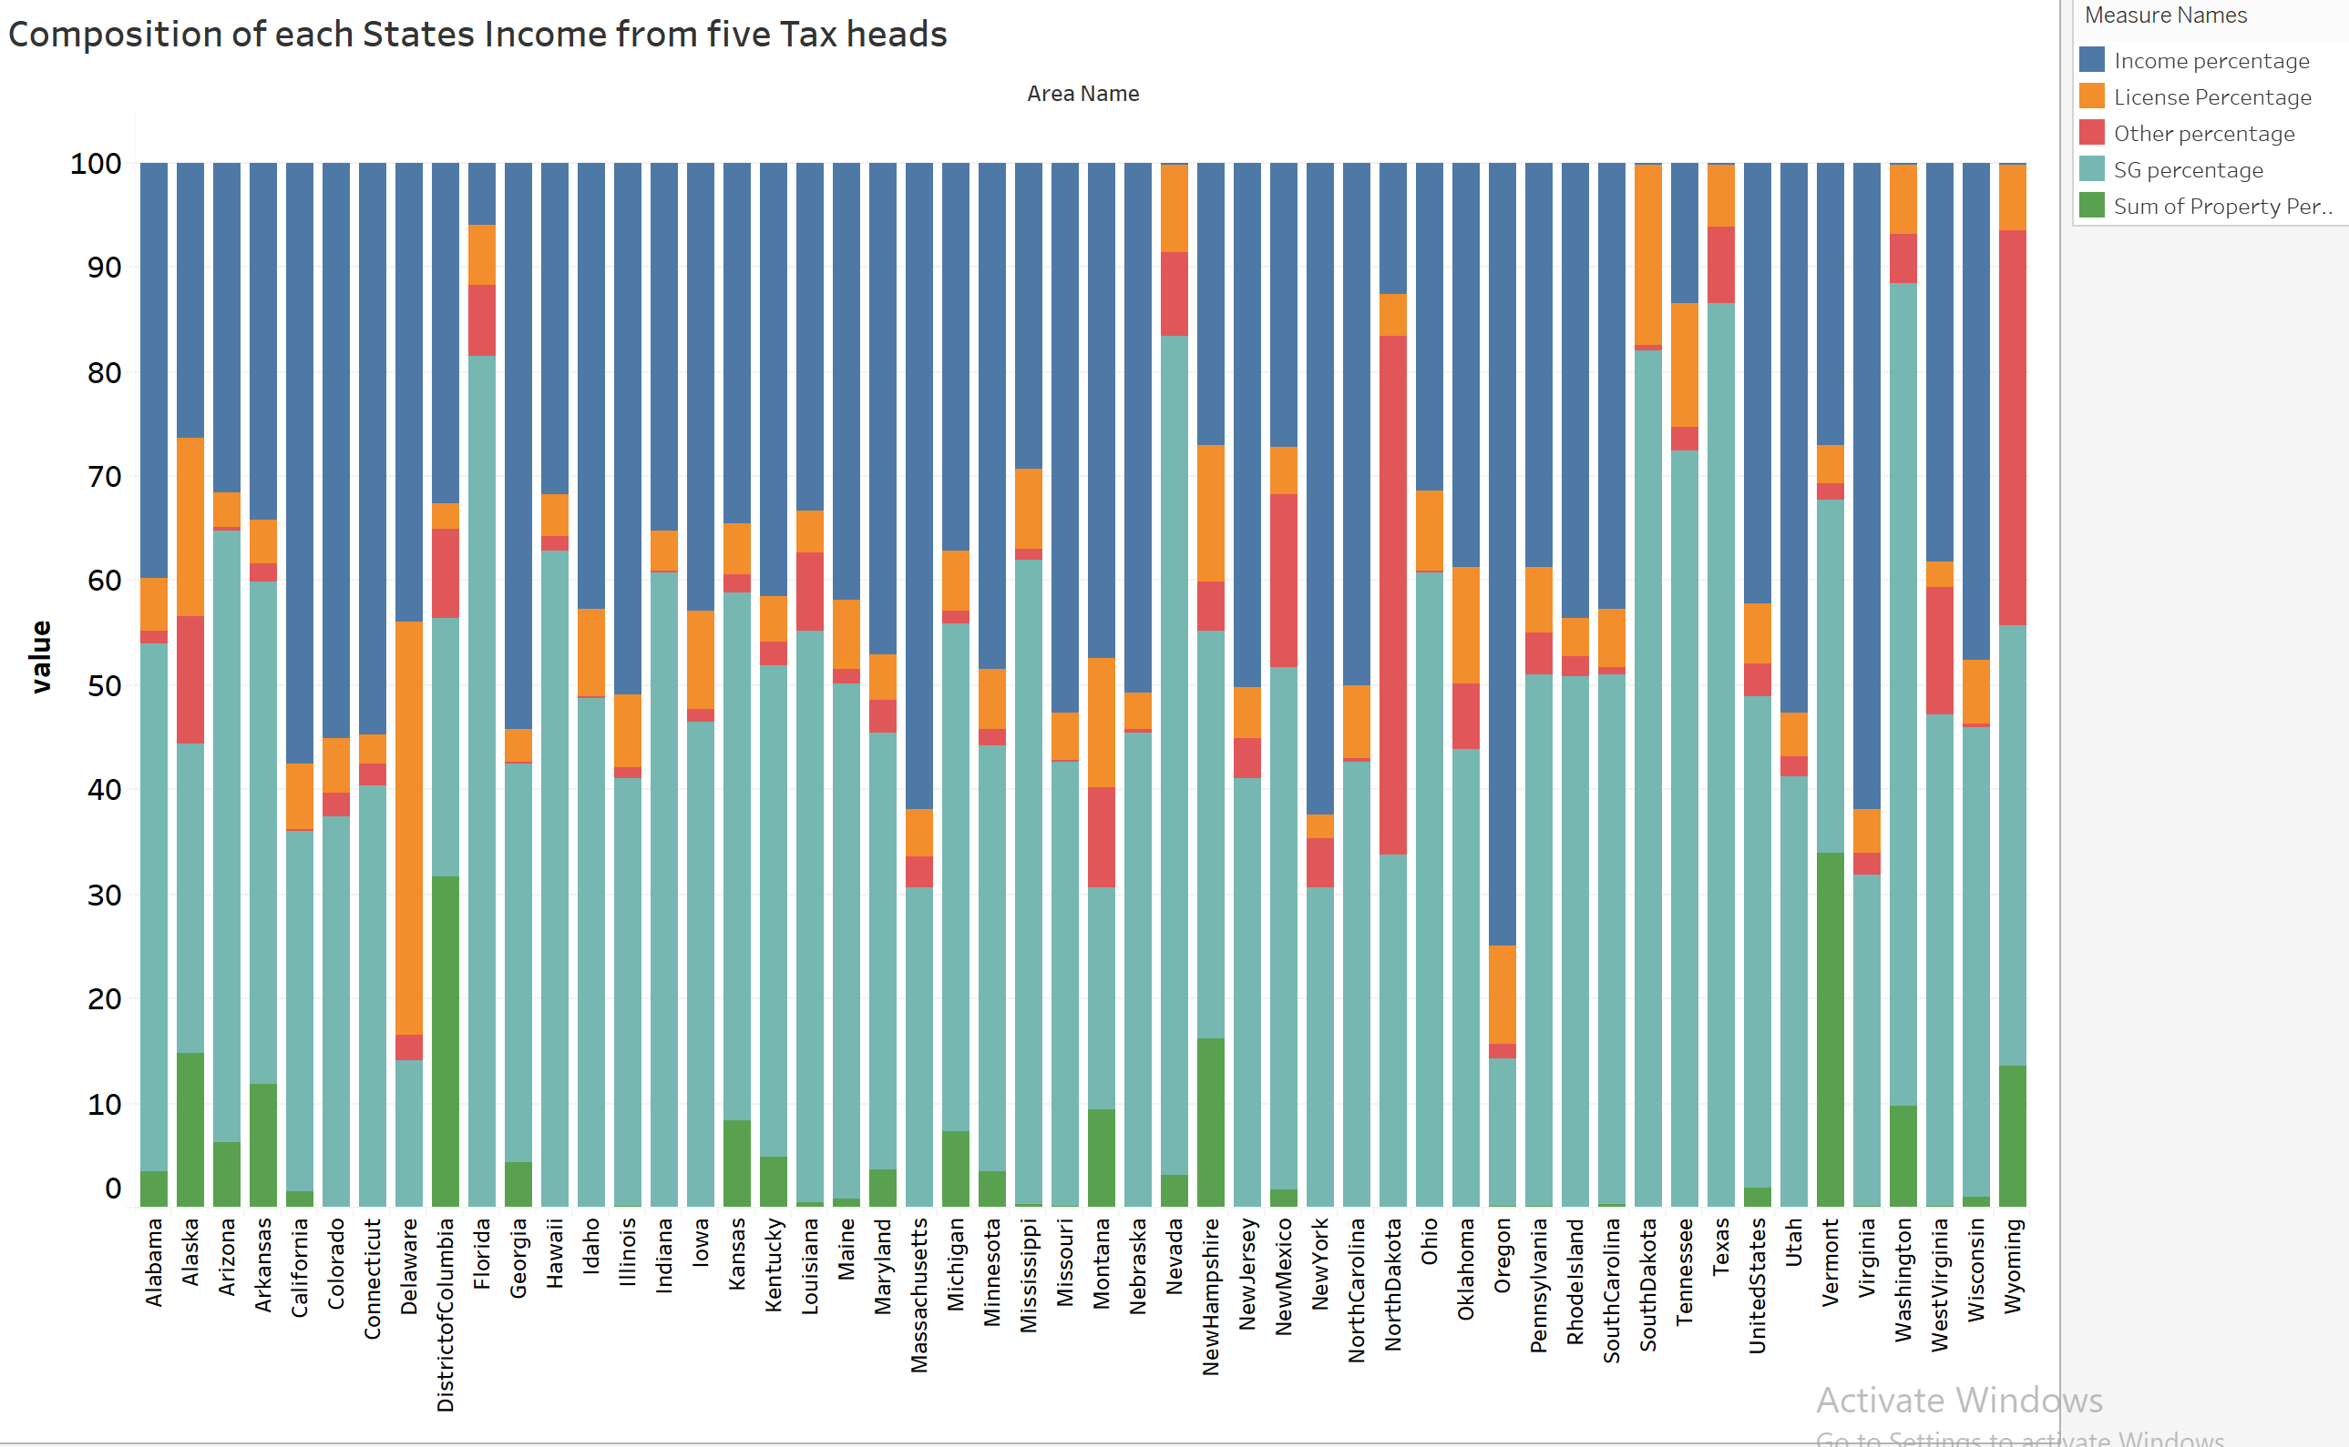
Most of the states have State Income from Salaries/S&G Taxes as their major tax revenue generation heads.

Slide 8
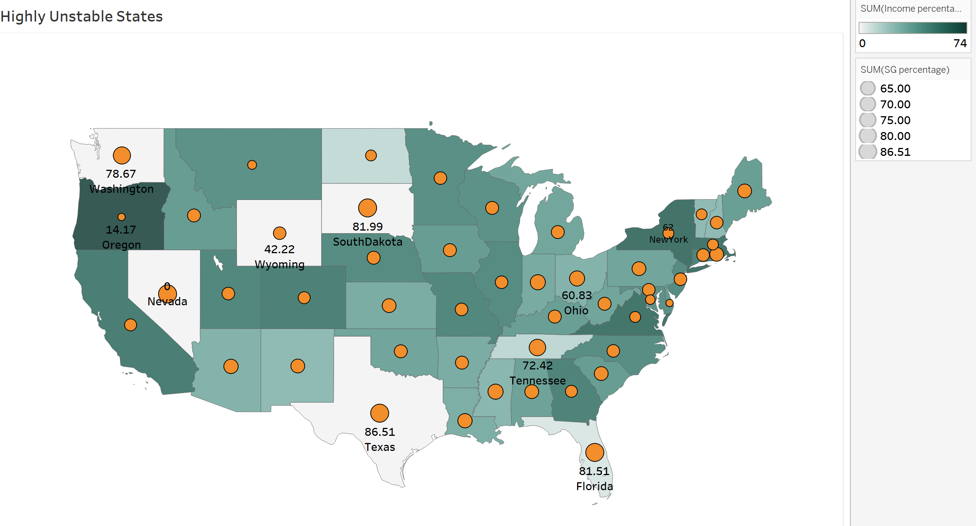
States with more than 60% of Tax Income from S&G tax / zero Income from Salaries

Slide 9
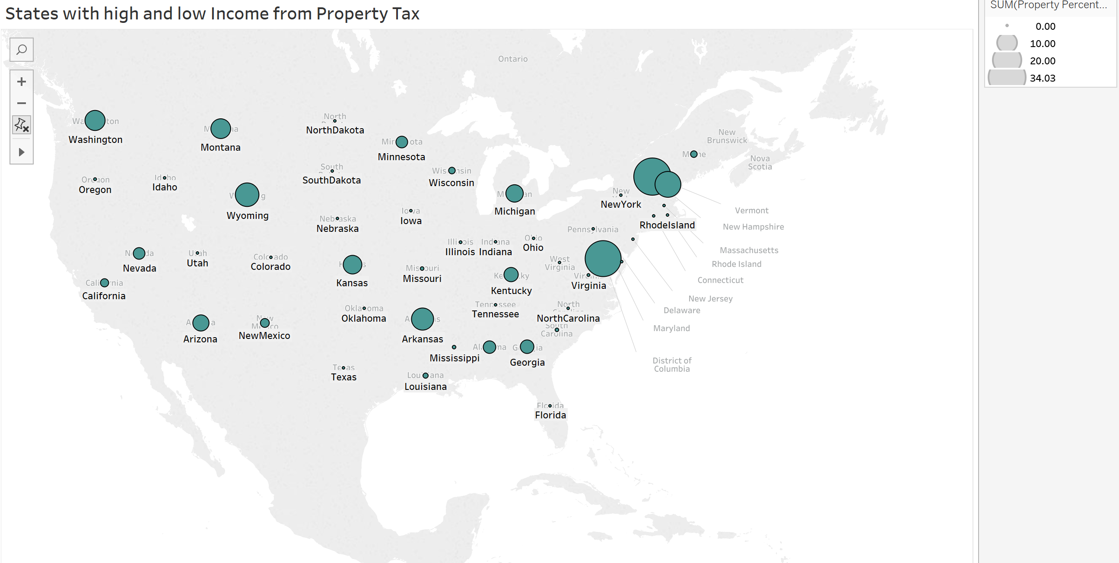
Vermont, District of Columbia and Washington are states with high income from property tax

Slide 10
Recommendation's
States' should reform their State Taxes to have a balanced Tax collection systems.
States should stop tax cuts.
Real estate investors or companies that invest in properties can invest in the states with zero income from property tax.
Retirees might consider to settle in States with zero income from Salaries to avoid Expense of Personal Income Tax from Salaries and save on Pension Income.

Slide 11
Thank You

